Slide 1
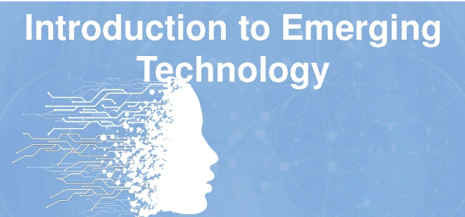
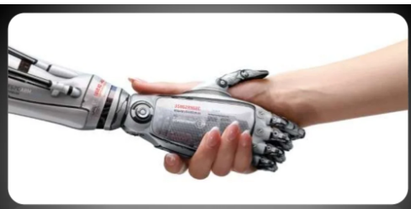
1. Introduction to Emerging Technologies
Adama Science and Technology University
Chapter Three
Artificial Intelligence

Slide 2
Topics Covered
Definitions of AI
Introduction of AI
Examples of Technologies that uses AI
Basic Components of AI
History of AI
Types of AI
Three types of learning that AI does
Branches of AI
Applications of AI
AI Tools

Slide 3
1. Definitions of AI
Systems that think like humans
Systems that think rationally
Systems that act like humans
Systems that act rationally
The term "Artificial Intelligence" refers to the simulation of human intelligence processes by machines, especially computer systems. It also includes Expert systems, voice recognition, machine vision, and natural language processing (NLP).

Slide 4
2. Introduction of Artificial Intelligence?
“is it possible to build a machine that has intelligence, specifically a human level of intelligence?”
Artificial Intelligence is
“The science and engineering of making intelligent machines, especially intelligent computer programs.”
“About algorithms enabled by constraints exposed by representations that support models targeted at thinking, perception and action.”
“The theory and development of computer systems able to perform tasks normally requiring human intelligence, such as visual perception, speech recognition, decision-making, and translation between languages. “
AI programming focuses on three cognitive aspects, such as learning, reasoning, and self-correction.
Learning Processes
Reasoning Processes
Self-correction Processes

Slide 5
AI Introduction Cont’d
AI is the creation of a computer program that can learn to think and function on its own, kind of like robots that don’t need to be told what to do all the time.
Most advanced AI systems use machine learning technology to analyze current conditions and learn from experience.

Slide 6
3. Examples of Technologies that used AI
Examples of technologies that uses AI
Machine Learning
Machine Automation
Virtual Reality
Cloud Computing
Augmented Reality
Neural Networks
Big Data
Internet of Things
Computer Vision
Popular successful Applications of AI
Robotics Google Maps and Ride-Hailing Applications.
Face Detection and recognition.
Text Editors and Autocorrect.
Chatbots.
E-Payments.
Search and Recommendation algorithms.
Digital Assistant.
Social media.

Slide 7
4. Basic components of AI
Learning
Reasoning
Problem
Solving
Perception
Language Understanding
Knowledge Representation

Slide 8
Components of AI system contd..
Applications: Image recognition, Speech recognition, Chatbots, Natural language generation, and Sentiment analysis.
Types of Models: Deep learning, Machine learning, and Neural Networks.
Software/Hardware for training and running models: Graphic Processing Units (GPUs), Parallel processing tools (like Spark), Cloud data storage and computer platforms.

Slide 9
Components of AI system contd..
4. Programming languages for building models: Python, TensorFlow, Java, and C/C⁺⁺, etc.

Slide 10
5. History of Artificial Intelligence (AI)
Formally initiated in 1956 and the name AI was coined by John McCarthy.
The advent of general purpose computers provided a vehicle for creating artificially intelligent entities.
Used for solving general-purpose problems
Which one is preferred?
General purpose problem solving systems
Domain specific systems

Slide 11
AI History Cont’d
Year | Description
1956 | The term “artificial intelligence” is coined by John McCharty at a Dartmouth conference and AI is founded as an academic discipline
1956–1974 | The golden years of AI enjoy government funding in promising, logic-based problem-solving approaches.
1974–1980 | Overly high expectations coupled with the limited capacities of AI programs leads to the first “AI winter”, with reduced funding and interest in AI research.
1980–1987 | The rise of knowledge-based expert systems brings new successes and a change in the focus of research and funding toward this form of AI.
1987–1993 | The second “AI winter” starts with the sudden collapse of the specialized hardware industry in 1987. The AI hype brings with it negative perceptions by governments and investors, as expert systems show their limitations and prove expensive to update and maintain.

Slide 12
AI History Cont’d
1993–2011 | Optimism about AI returns and increases. New successes are marked with the help of increased computational power and AI becomes data-driven.
 | In 1997, IBM’s DeepBlue beats world champion Gary Kasparov at chess.
 | In 2002, Amazon uses automated systems to provide recommendations.
 | In 2011, Apple releases Siri and IBM Watson beats two human champions at the TV quiz Jeopardy.
2012–today | Increased availability of data, connectedness and computational power allow for breakthroughs in machine learning, mainly in neural networks and deep learning, heralding a new era of increased funding and optimism about the AI potential.
 | In 2012, Google driverless cars navigate autonomously and in 2016 Google AlphaGo beats a world champion in the complicated board game Go.

Slide 13
6. Types of AI
Based on the level of intelligence embedded into a machine AI is divided into three. The following three stages through which AI can evolve
Artificial Narrow Intelligence (Weak AI or Narrow AI
Artificial General Intelligence (General AI or Strong AI)
Artificial Super Intelligence (Super AI)

Slide 14
Types of Learning in AI Cont’d
1. Artificial Narrow Intelligence (Weak AI or Narrow AI)
a type of AI which is able to perform a dedicated task with intelligence.
The most common and currently available.
It is only trained for one specific task, cannot perform beyond its field or limitations
Example of narrow AI
Playing chess,
Purchasing suggestions on e-commerce site,
Self-driving cars,
Speech recognition, and
Image recognition.

Slide 15
Types of Learning in AI Cont’d
2. Artificial General Intelligence (General AI or Strong AI)
A type of intelligence which could perform any intellectual task with efficiency like a human.
The idea is to make a system which could be smarter and think like a human by its own.
General AI systems are still under research.

Slide 16
Types of Learning in AI Cont’d
3. Artificial Super Intelligence (Super AI)
a level of Intelligence of Systems at which machines could surpass human intelligence, and can perform any task better than human with cognitive properties.
an outcome of general AI.
Characteristics of strong AI include the ability to think, to reason, solve the puzzle, make judgments, plan, learn, and communicate by its own.
Development of such systems in real is still world changing task.

Slide 17
Types of Learning in AI Cont’d
Based on capabilities
Reactive Machines: Purely reactive machines are the most basic types of Artificial Intelligence. Such AI systems do not store memories or past experiences for future actions. These machines only focus on current scenarios and react on it as per possible best action.
IBM's Deep Blue system and Google’s AlphaGo is an example of reactive machines.

Slide 18
Types of Learning in AI Cont’d
2. Limited Memory: Limited memory machines can store past experiences or some data for a short period of time. These machines can use stored data for a limited time period only.
Self-driving cars are one of the best examples of Limited Memory systems. These cars can store recent speed of nearby cars, the distance of other cars, speed limit, and other information to navigate the road.

Slide 19
Types of Learning in AI Cont’d
3. Theory of Mind: Theory of Mind AI should understand the human emotions, people, beliefs, and be able to interact socially like humans. This type of AI machines are still not developed, but researchers are making lots of efforts and improvement for developing such AI machines.
Sophia – the humanoid robot is one example of such effort where a number of young Ethiopians have contributed on the development.[

Slide 20
Types of Learning in AI Cont’d
4. Self–Awareness: Self-awareness AI is the future of Artificial Intelligence. These machines will be super intelligent, and will have their own consciousness, sentiments, and self-awareness. These machines will be smarter than human mind.
Self-Awareness AI does not exist in reality still and it is a hypothetical concept.

Slide 21
7. Three types of Learning that AI does
1. Supervised Learning: The machine has a “teacher” who guides it by providing sample inputs along with the desired output. The machine then maps the inputs and the outputs. This is similar to how we teach very young children with picture books. According to Yann LeCun, all of the AI machines we have today have used this form of learning (from speech recognition to self-driving cars).

Slide 22
Three types of Learning that AI does contd…
2. Unsupervised Learning: This is the most important and most difficult type of learning and would be better titled Predictive Learning. In this case the machine is not given any labels for its inputs and needs to “figure out” the structure on its own. This is similar to how babies learn early in life. For example they learn that if an object in space is not supported it will fall

Slide 23
Three types of Learning that AI does contd…
3.Reinforcement Learning: Yann LeCun believes this plays a relatively minor role in training AI and is similar to training an animal. When the animal displays a desired behavior it is given a reward. reinforcement learning is defined as “a computer program interacts with a dynamic environment in which it must perform a certain goal (such as driving a vehicle), without a teacher explicitly telling it whether it has come close to its goal. “

Slide 24
Other learning problems
Hybrid Learning Problems
4. Semi-Supervised Learning
5. Self-Supervised Learning
6. Multi-Instance Learning
Statistical Inference
7. Inductive Learning
8. Deductive Inference
9. Transductive Learning
Learning Techniques
10. Multi-Task Learning
11. Active Learning
12. Online Learning
13. Transfer Learning
14. Ensemble Learning

Slide 25
8. Major Branches of AI

Slide 26
9. Applications of AI

Slide 27
Applications of AI Contd..
Robotics
Industrial Robots
Hand Writing Recognition
Machine Translation
Virtual Assistance
Autonomous Driving
AI in Military (Army)

Slide 28
Many other AI applications

Slide 29
Applications of AI Contd..
Currently, AI is being applied across several industries. But we cannot say that AI is replacing humans but it is certainly making the work of human beings more efficient.
Agriculture
AI technologies are being used to yield healthier crops, control pests, monitor soil and growing conditions, organize data for farmers, help with workload, and improve a wide range of agriculture-related tasks in the entire food supply chain.

Slide 30
AI Applications Cont’d
Agricultural Robots
Companies are developing and programming autonomous robots to handle essential agricultural tasks such as harvesting crops at a higher volume and faster pace than human laborers.
Examples of AI applications in the agriculture sector.
See & Spray Robot
Harvest CROO Robotics
Crop and Soil Monitoring

Slide 31
Applications of AI Cont’d
2. Health
AI applications are revolutionizing how the health sector works to reduce spending and improve patient outcomes.
Companies are applying machine learning to make better and faster diagnoses than humans.
One of the best known healthcare technologies is IBM Watson.
Other AI applications include chatbots.

Slide 32
AI applications Cont’d.
Personal Health Virtual Assistant
Examples of AI applications in the health sector.
Dip.io
Apple Watch
Medical Imaging Analysis
IBM Watson analysis
IDx software
Precision Medicine
Healthcare Bots
Operational applications of AI

Slide 33
AI Applications Cont’d
3. Business (Emerging market)
Artificial Intelligence has enormous potential to augment human intelligence and to radically alter how we access products and services, gather information, make products, and interact.
In emerging markets, AI offers an opportunity to lower costs and barriers to entry for businesses and deliver innovative business models that can leapfrog traditional solutions and reach the underserved.

Slide 34
AI Applications in Business
Examples of AI applications in the Business sector.
Improve Customer Services
Automate Workloads
Optimize Logistics
Increase Manufacturing Output and Efficiency
Prevent Outages
Predict Performance
Predict Behavior
Manage and Analyze Data
Improve Marketing and Advertising

Slide 35
AI in Education
4. Education
The increasing adoption of the AI technology for various applications in the education sector.
AI can automate grading, giving educators more time, and can also assess students and adapt to their needs, helping them work at their own pace. AI tutors can provide additional support to students, ensuring they stay on track.

Slide 36
AI in Education Cont’d
Examples of AI applications in the Education sector.
Administrative Tasks Automation
Smart Content
Smart Tutors and Personalization
Virtual Lectures and Learning Environment
Teachers’ Support
Students’ Communication

Slide 37
AI Tools
Scikit Learn
TensorFlow
PyTorch
CNTK
Caffe(Coding)
Apache MXNet
Keras
OpenNN(S/w Devp)
AutoML
H2OAI(Specialty:
(Business intelligence)
ZIA BY ZOHO
Specialty: Business intelligence
TIMEHERO
Specialty: Scheduling
SYMANTEC ENDPOINT PROTECTION
Specialty: Cybersecurity
OUTMATCH
Specialty: Recruiting
TABLEAU
Specialty: Business intelligence
SALESFORCE
Specialty: Business intelligence
ORACLE AI
Specialty: Software development
SAS
Specialty: Business Intelligence
THEANO
Specialty: Code development
TELLIUS
Specialty: Business intelligence
GONG.IO
Specialty: Sales

Slide 38
Programming language is used for AI?
Python
Java
Lisp
R
Prolog

Slide 39
Review Questions
1. What do you understand by Artificial Intelligence?
2. Give some real-world applications of AI.
3. How Artificial intelligence, Machine Learning, and Deep Learning differ from each other?
4. What are the types of AI?
5. What are the different domains/Subsets of AI?
6. What is Strong AI, and how is it different from the Weak AI?
7. Where does Artificial Intelligence go from here?
8. What are the different types of Learning/ Training models in ML?
9. What is the main key difference between supervised and unsupervised machine learning?
10. What Are The Branches Of Ai?
11. What Are The Various Areas Where Ai (artificial Intelligence) Can Be Used?

Slide 40
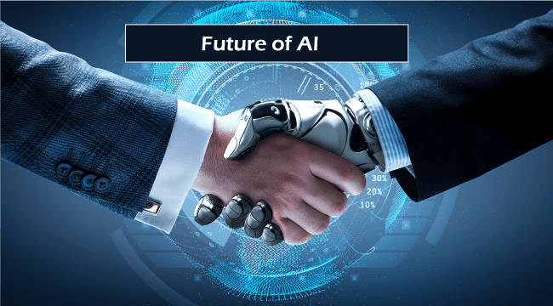
End of Chapter Three!

